Slide 1
Ball Game!
This is a guide to your presentation format – remember you only have a few minutes to present

Slide 2
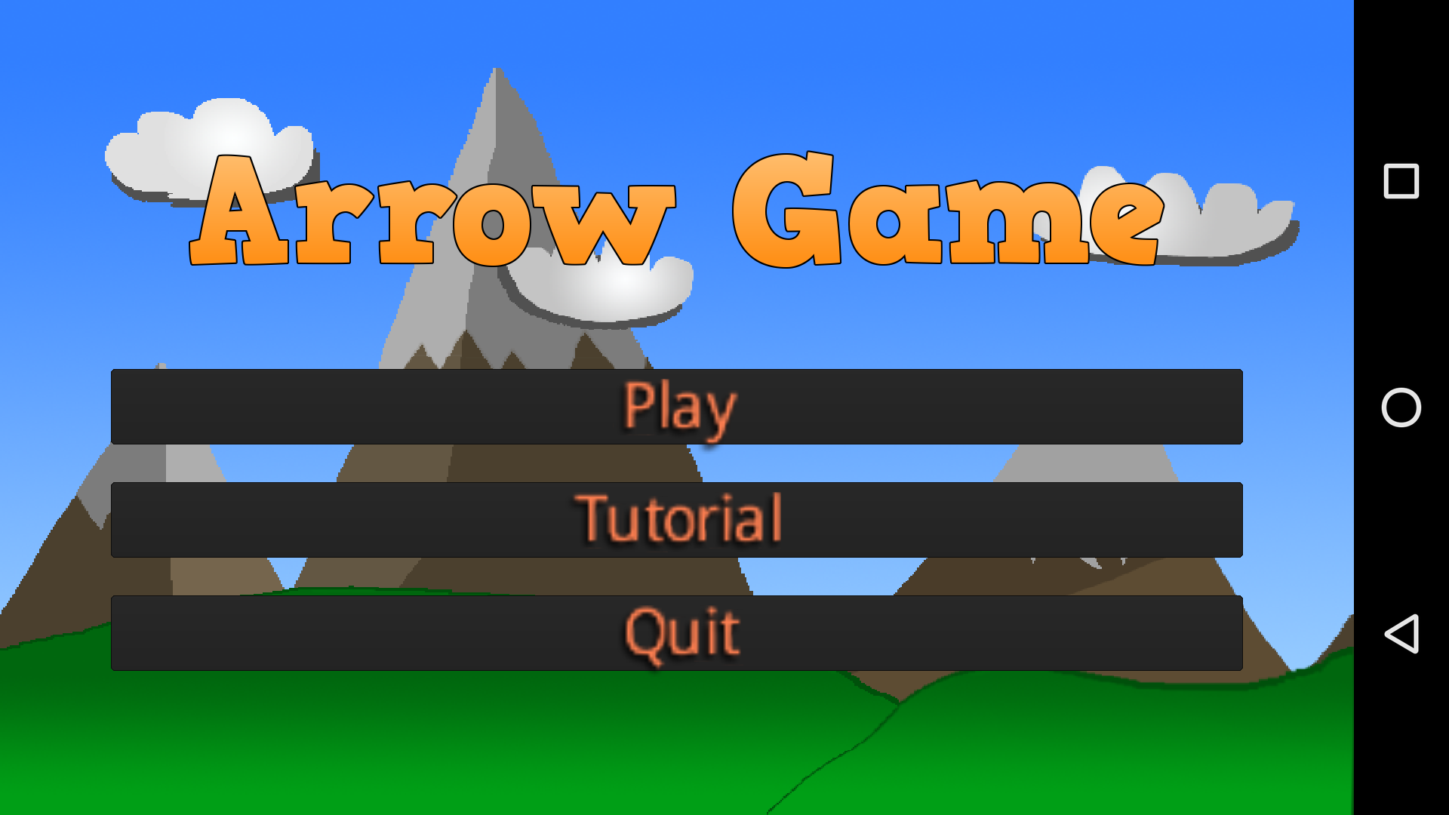
The Ball Game
21238D Gouhe001, Malty003, Nguty218

Slide 3
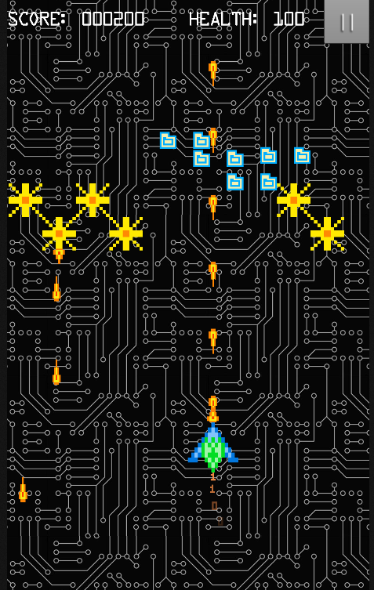
Mechanics
A quick summary of how the game works just before the demo
The player moves the ball around using touch inputs
The ball constantly rotates to add direction to the ball movement
The ball bounces off of obstacle walls to stall the player from getting to the goal
Each level has a set amount of turns to be able to complete the level in
Once you have reached the goal you immediately progress to the next level

Slide 4
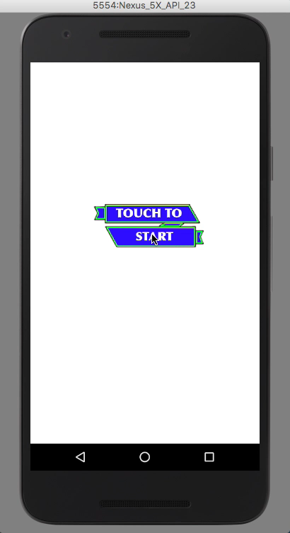
Demo-Tower Defence
The demo can be on a real game or (safer!) using a short video screen grab. It can be on a real phone or an emulator.
Note that the demo in the lab must be on a real device.

Slide 5
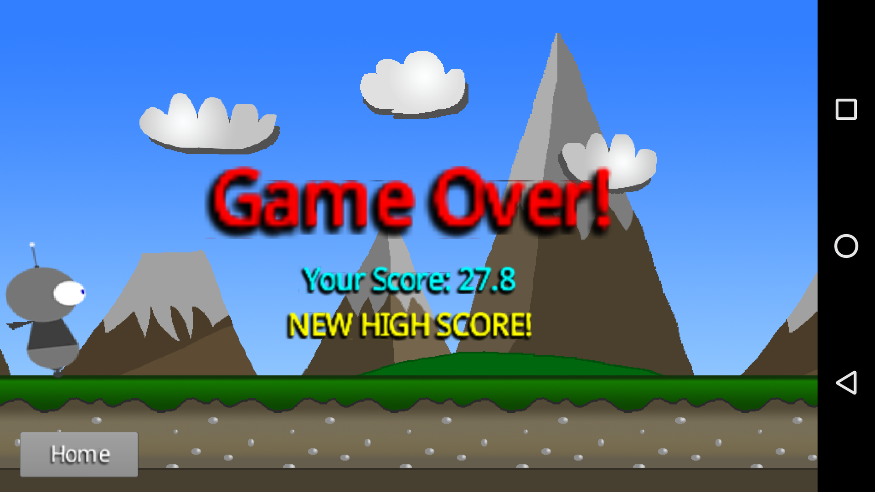
Player Experience Goals
You must state these goals
The objective of the game is move the player to the goal within the turn limit.
The game is a casual gaming experience with a major focus on puzzle and problem solving aspects
The player should be challenged and feel a sense of accomplishment at the completion of each level

Slide 6
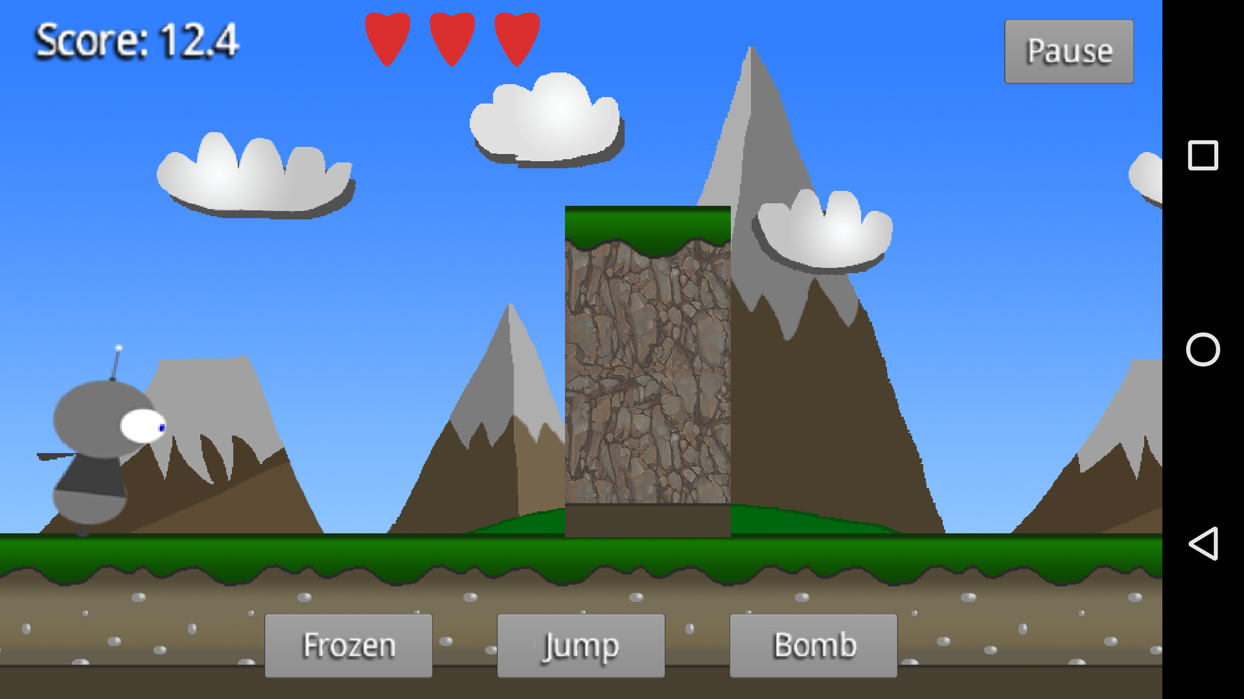
Play Testing Results
You must report some play testing results and hopefully some improvements you have made as a result of play testing
Play testing resulted in both positive and negative feedback
Play testers said they enjoyed the game and found it relaxing
Positive features highlighted were that it was simple yet challenging and it felt nostalgic
Negative feedback included the clarity, the slow pace and the background look
Some playtesters said that the game felt too slow, as in the time waiting between turns was too long, this time was adjusted to reduce this issue
The speed at which the player moves has also been continually adjusted based on play testing

Slide 7
Play Testing
This is a better slide on play testing !
Play testing in the beginning revealed that the game play was too slow to maintain attention from the player
We solved this by making the ball rotate and move faster which in turn made a much better play experience
In later play tests we were told that the game was far more enjoyable and if we could fix the collision with the goal it would be fantastic
We remedied the issues with the goal by removing collision and just checking if the player was in a certain location
Play testers said that they enjoyed how it is deceptively challenging

Slide 8
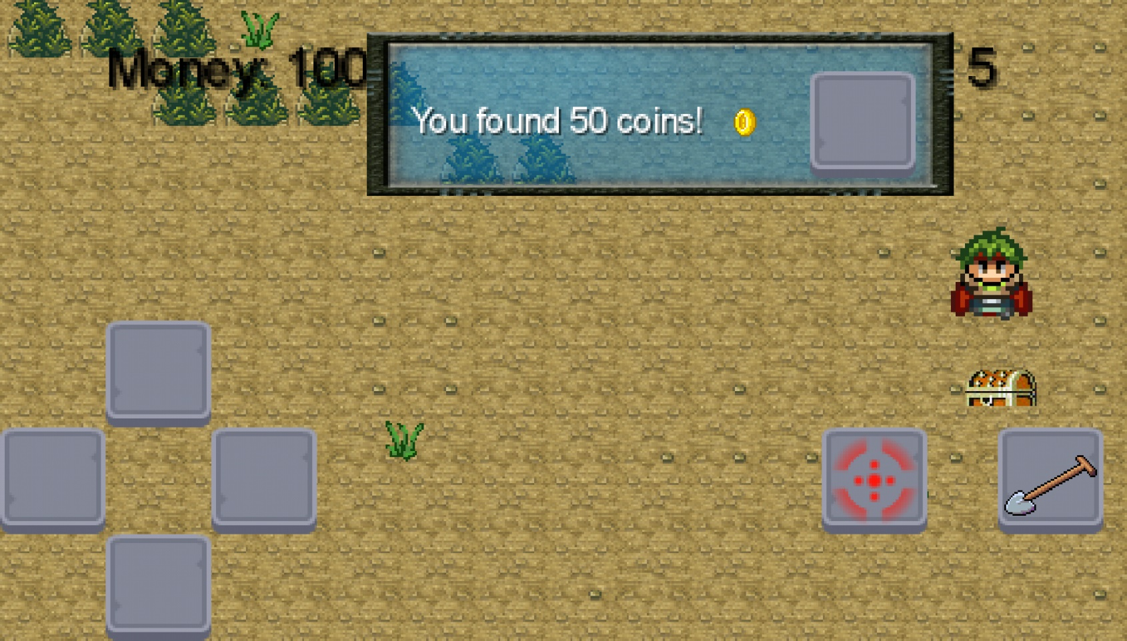
Game Construction
A single slide summary of the major elements of the game internals
The games physics are based on the Box2D
The objects are all based on Box2D
The goal sprite was created using photoshop
The BGM was created using FLStudio
Music from Overclocked Remix: http://ocremix.org/

